Slide 1
Python - Object Oriented

Slide 2
Python - Object Oriented
Class − A user-defined prototype for an object that defines a set of attributes that characterize any object of the class. The attributes are data members (class variables and instance variables) and methods, accessed via dot notation.
Class variable − A variable that is shared by all instances of a class. Class variables are defined within a class but outside any of the class's methods. Class variables are not used as frequently as instance variables are.
Data member − A class variable or instance variable that holds data associated with a class and its objects.
Function overloading − The assignment of more than one behavior to a particular function. The operation performed varies by the types of objects or arguments involved.
Instance variable − A variable that is defined inside a method and belongs only to the current instance of a class.
Inheritance − The transfer of the characteristics of a class to other classes that are derived from it.
Instance − An individual object of a certain class. An object obj that belongs to a class Circle, for example, is an instance of the class Circle.
Instantiation − The creation of an instance of a class.
Method − A special kind of function that is defined in a class definition.
Object − A unique instance of a data structure that's defined by its class. An object comprises both data members (class variables and instance variables) and methods.
Operator overloading − The assignment of more than one function to a particular operator.

Slide 3
Creating Classes
class ClassName:
'Optional class documentation string'
class_suite
The class has a documentation string, which can be accessed via ClassName.__doc__.
The class_suite consists of all the component statements defining class members, data attributes and functions.

Slide 4
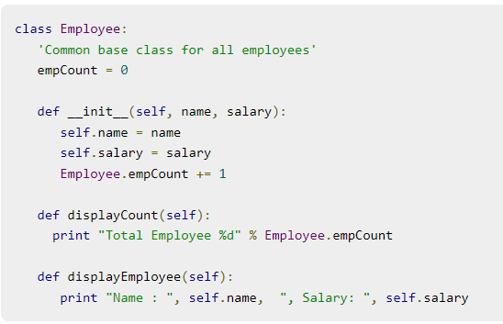
Example

Slide 5
Creating Instance Objects
"This would create first object of Employee class“
emp1 = Employee("Zara", 2000)
"This would create second object of Employee class"
emp2 = Employee("Manni", 5000)

Slide 6
Accessing Attributes
emp1.displayEmployee()
emp2.displayEmployee()
print "Total Employee %d" % Employee.empCount

Slide 7
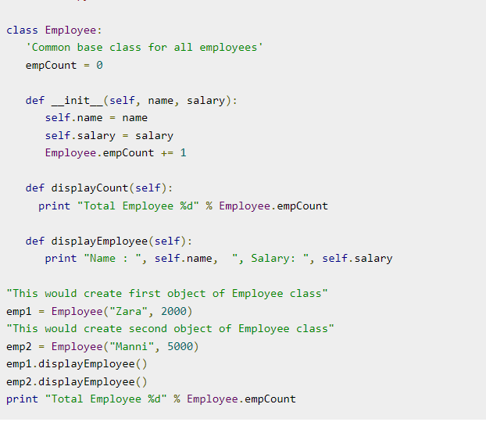

Slide 8
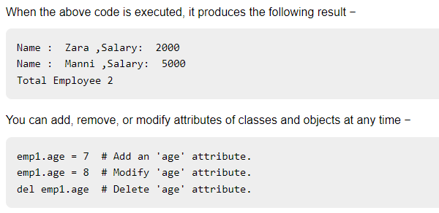

Slide 9
Class Inheritance
Instead of starting from scratch, you can create a class by deriving it from a preexisting class by listing the parent class in parentheses after the new class name.
The child class inherits the attributes of its parent class, and you can use those attributes as if they were defined in the child class. A child class can also override data members and methods from the parent.

Slide 10
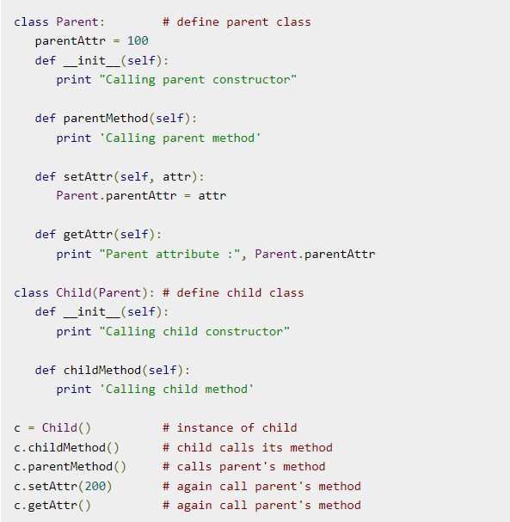

Slide 11
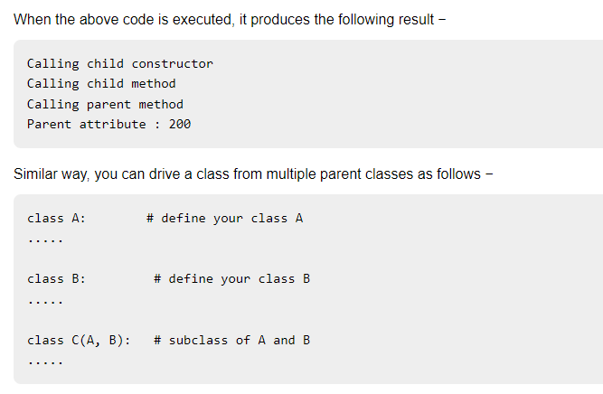

Slide 12
Overriding Methods
You can always override your parent class methods. One reason for overriding parent's methods is because you may want special or different functionality in your subclass.

Slide 13
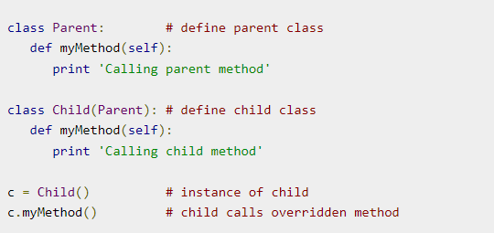

Slide 14
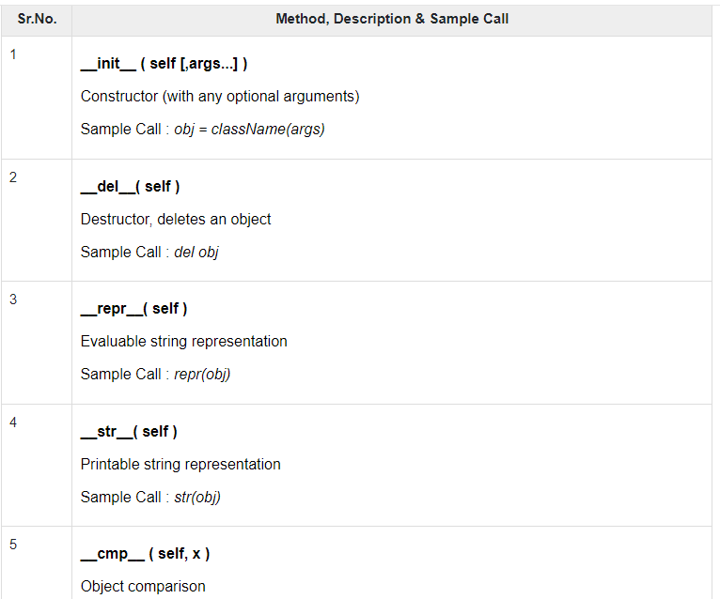

Slide 15
Overloading Operators
Suppose you have created a Vector class to represent two-dimensional vectors, what happens when you use the plus operator to add them? Most likely Python will yell at you.
You could, however, define the __add__ method in your class to perform vector addition and then the plus operator would behave as per expectation −

Slide 16
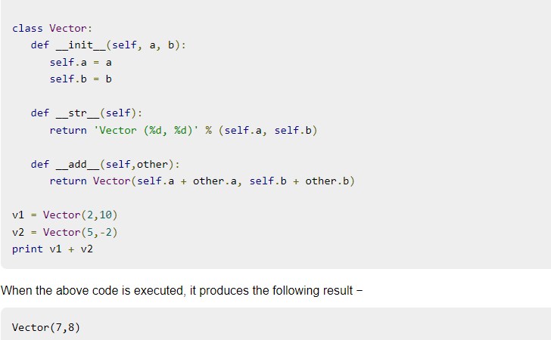

Slide 17
Data Hiding
An object's attributes may or may not be visible outside the class definition. You need to name attributes with a double underscore prefix, and those attributes then are not be directly visible to outsiders.

Slide 18
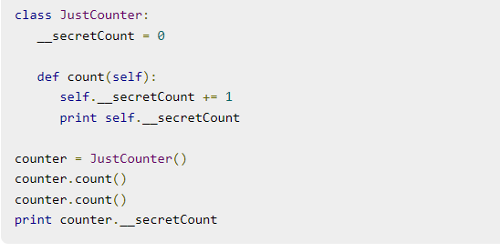

Slide 19
Continue . . .

